Slide 1
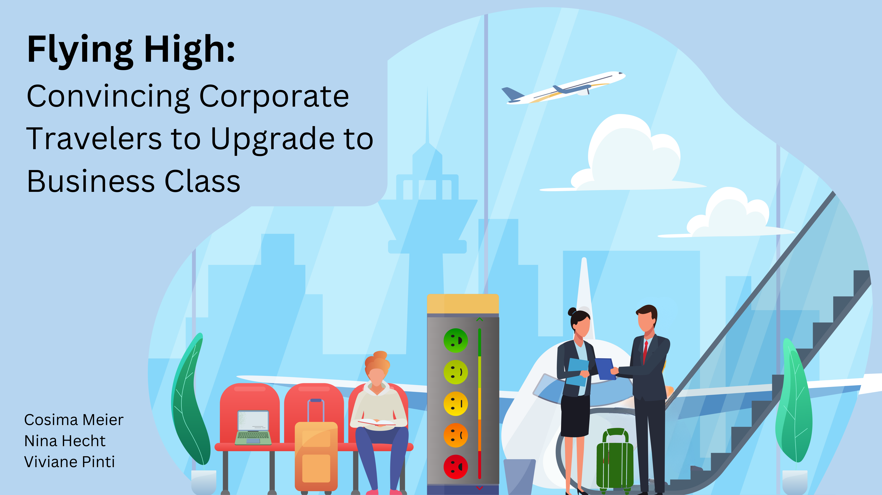
Notes:
Hi ,everyone! We are excited to share and discuss with you our data analytics project. The title of your project is: Flying High: Convincing corporate travelers to upgrade to business class. This titel already alludes to our objective. However, before delving into further details, let me first explain the rationale behind our approach.

Slide 2
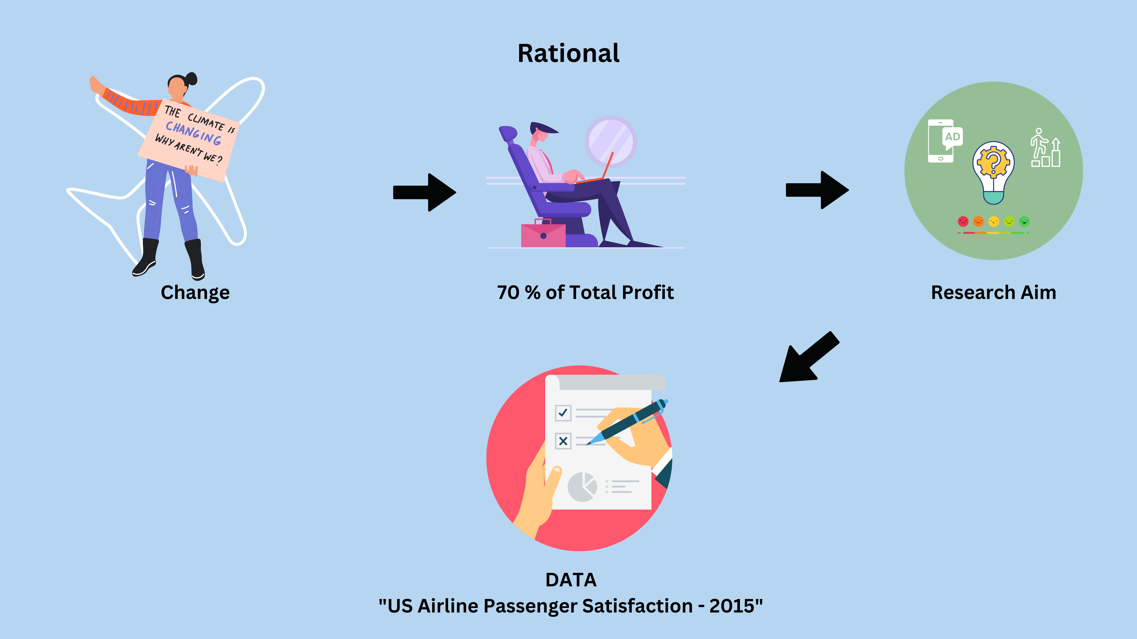
Notes:
Climate change and the respective mitigation actions taken also affect the aviation industry by potentially reducing the amount of air travel. This is because people may become more aware of the CO2 impact of flying on the planet and global warming. This will lead to fewer customers and therefore increased competition between airlines. It is therefore important for airlines to gain a competitive edge, for example by ensuring that their customers' needs are met.
A very important customer segment to be aware of is corporate travelers. Not only will they continue to travel for specific business reasons, but they also generate up to 70% of total profits by flying business or first class. It is therefore important to understand the needs of these valuable customers. Interestingly, not all corporate travelers fly business class, some also fly economy. Since business class is tailored to the needs of business travelers, a lot of profit and perhaps even satisfaction is lost. And this leads as straight to our research aim
Our aim is to identify which services should be marketed to corporate travelers flying economy class to convince them to upgrade to business class. By doing so, we can enhance passenger satisfaction for the airline, providing them with a competitve advantage and driving profitabillity for this airline.
We do not, however, aim to improve the services.
To answer this research question, we worked with the US Airline passenger Satisfaction Data set from 2015. This dataset includes ratings of 14 air travel services (on a 5-point likert scale ) as well as additional information about each passenger, such as their class and type of travel. In total about 130’000 individuals particpated in these surveys.

Slide 3
1) Data Wrangling:
Created subset only with necessary variables
NA’s analysis: For each satisfaction variable: between mind. 0% ; max: 5.14% (mean: 0.8%)
Final plot only works with data from corporate travelers
2) Generate first Insight:
Investigated the different mean satisfaction between corporate and personal travellers between Business and Eco class:
Corporate travelers were less satisfied in economoy class than personal travelers
Corporate travelers were more satisfied in business class than personal travelers
-→ Needs of corporate travelers are not fully met in economoy class & they would be more satifisied upgrading to business class
Tried a few plots to answer our research question: (following slides)
Reflection
- Nicht immer inferenzstatistik betreiben (haben wir direkt gemacht)

Slide 4
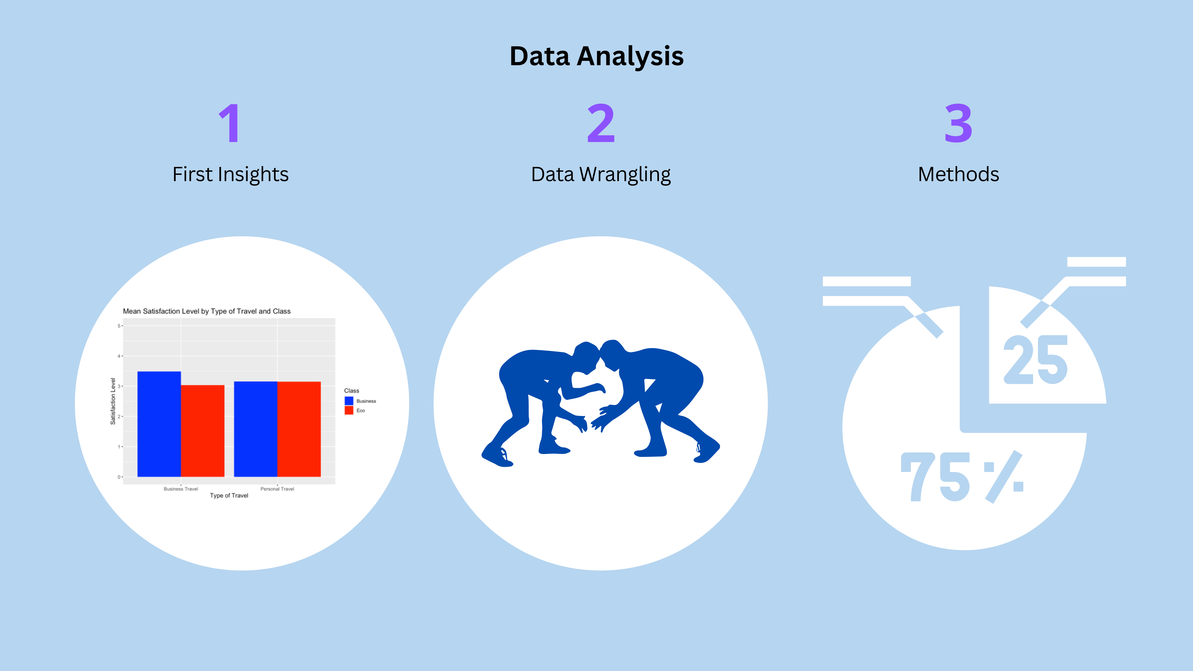
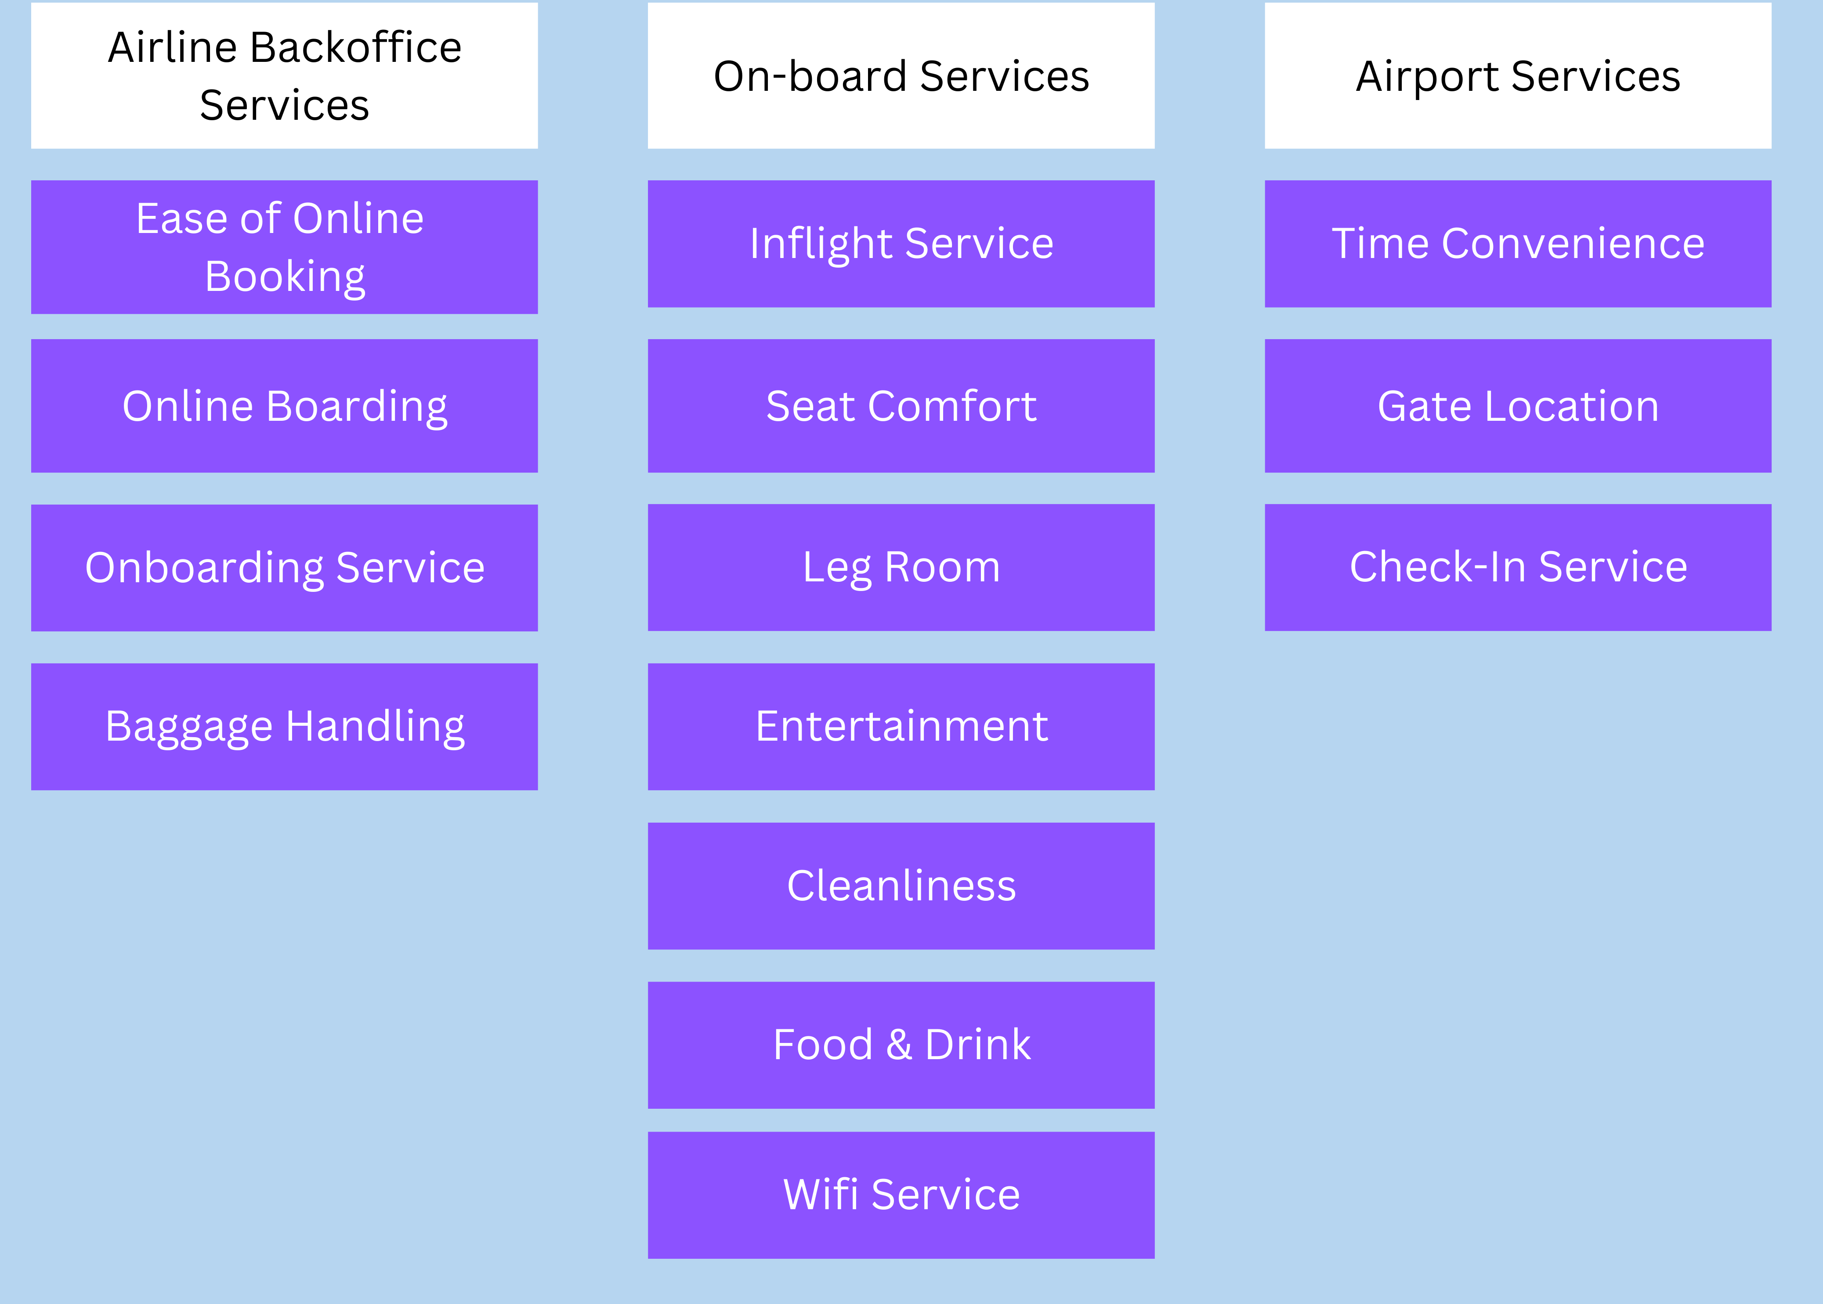

Slide 5
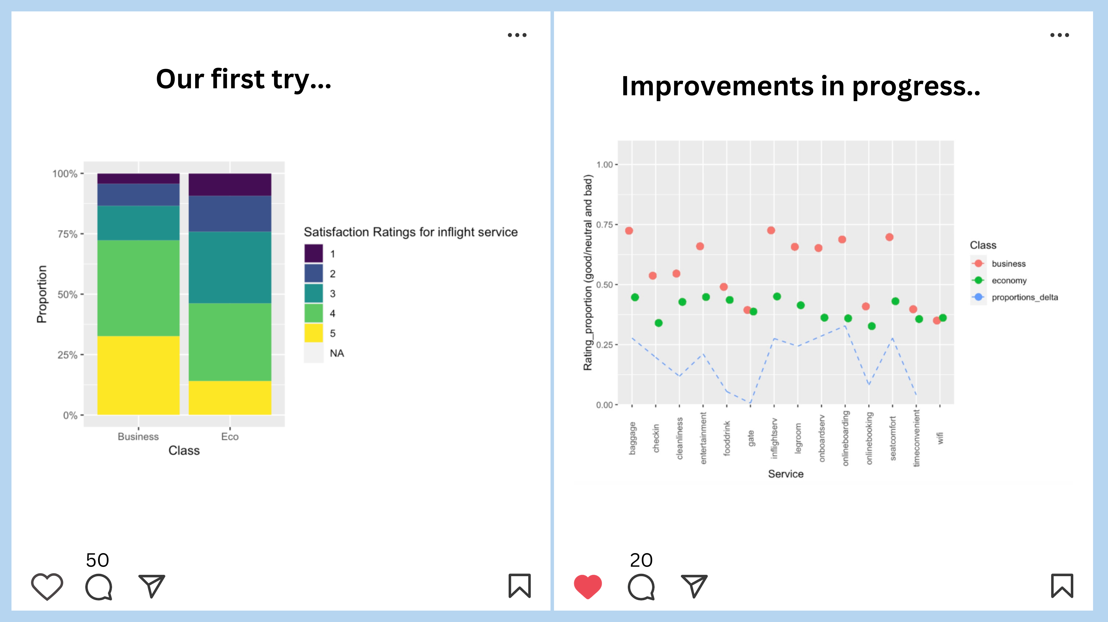

Slide 6
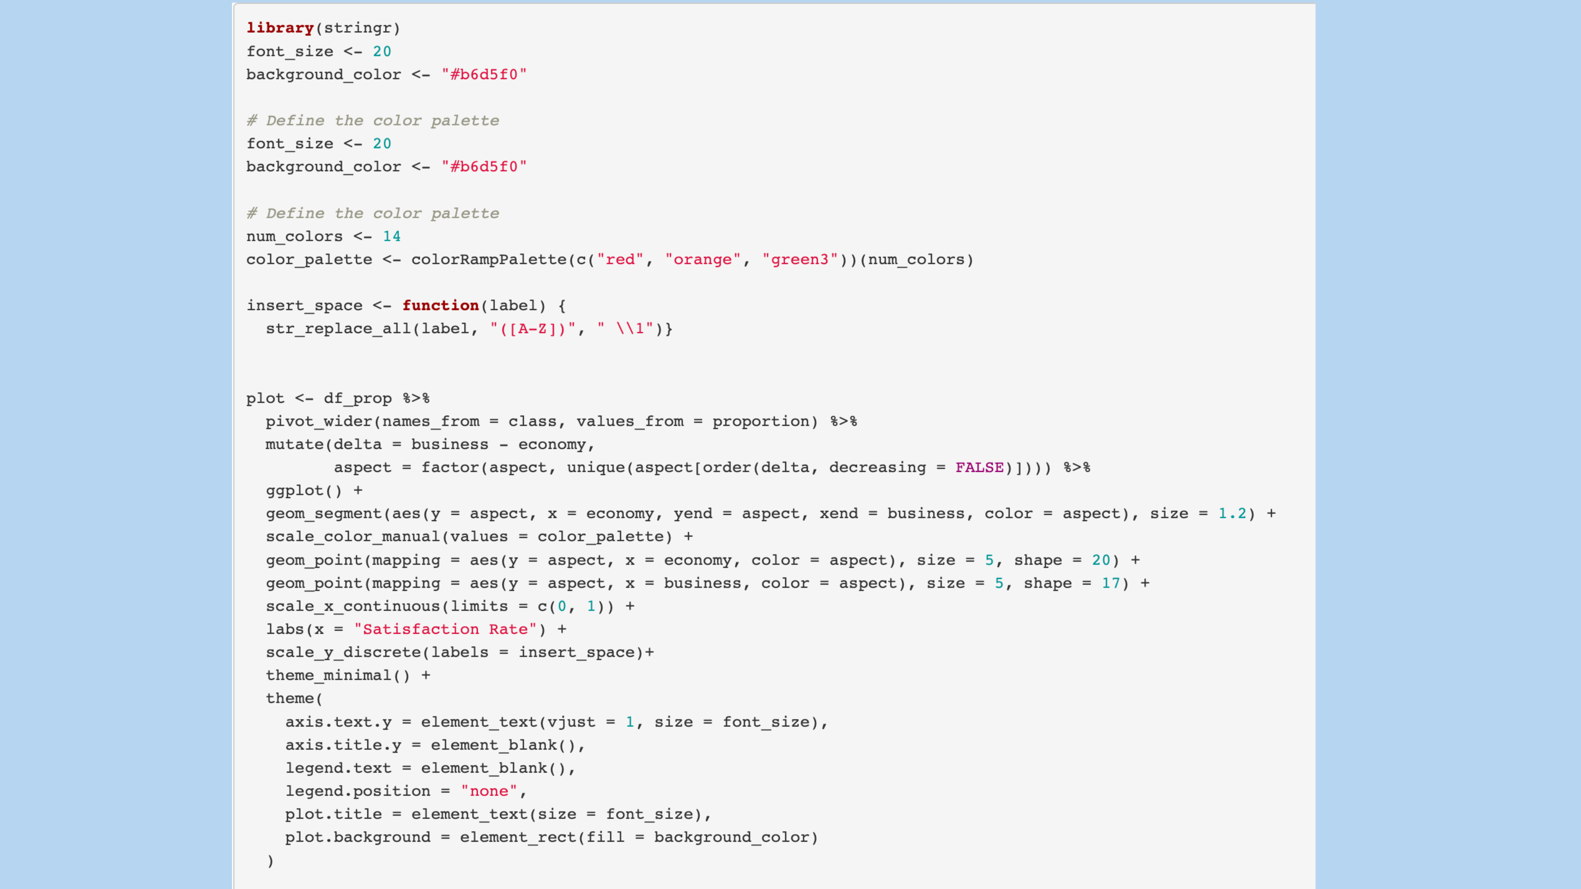

Slide 7
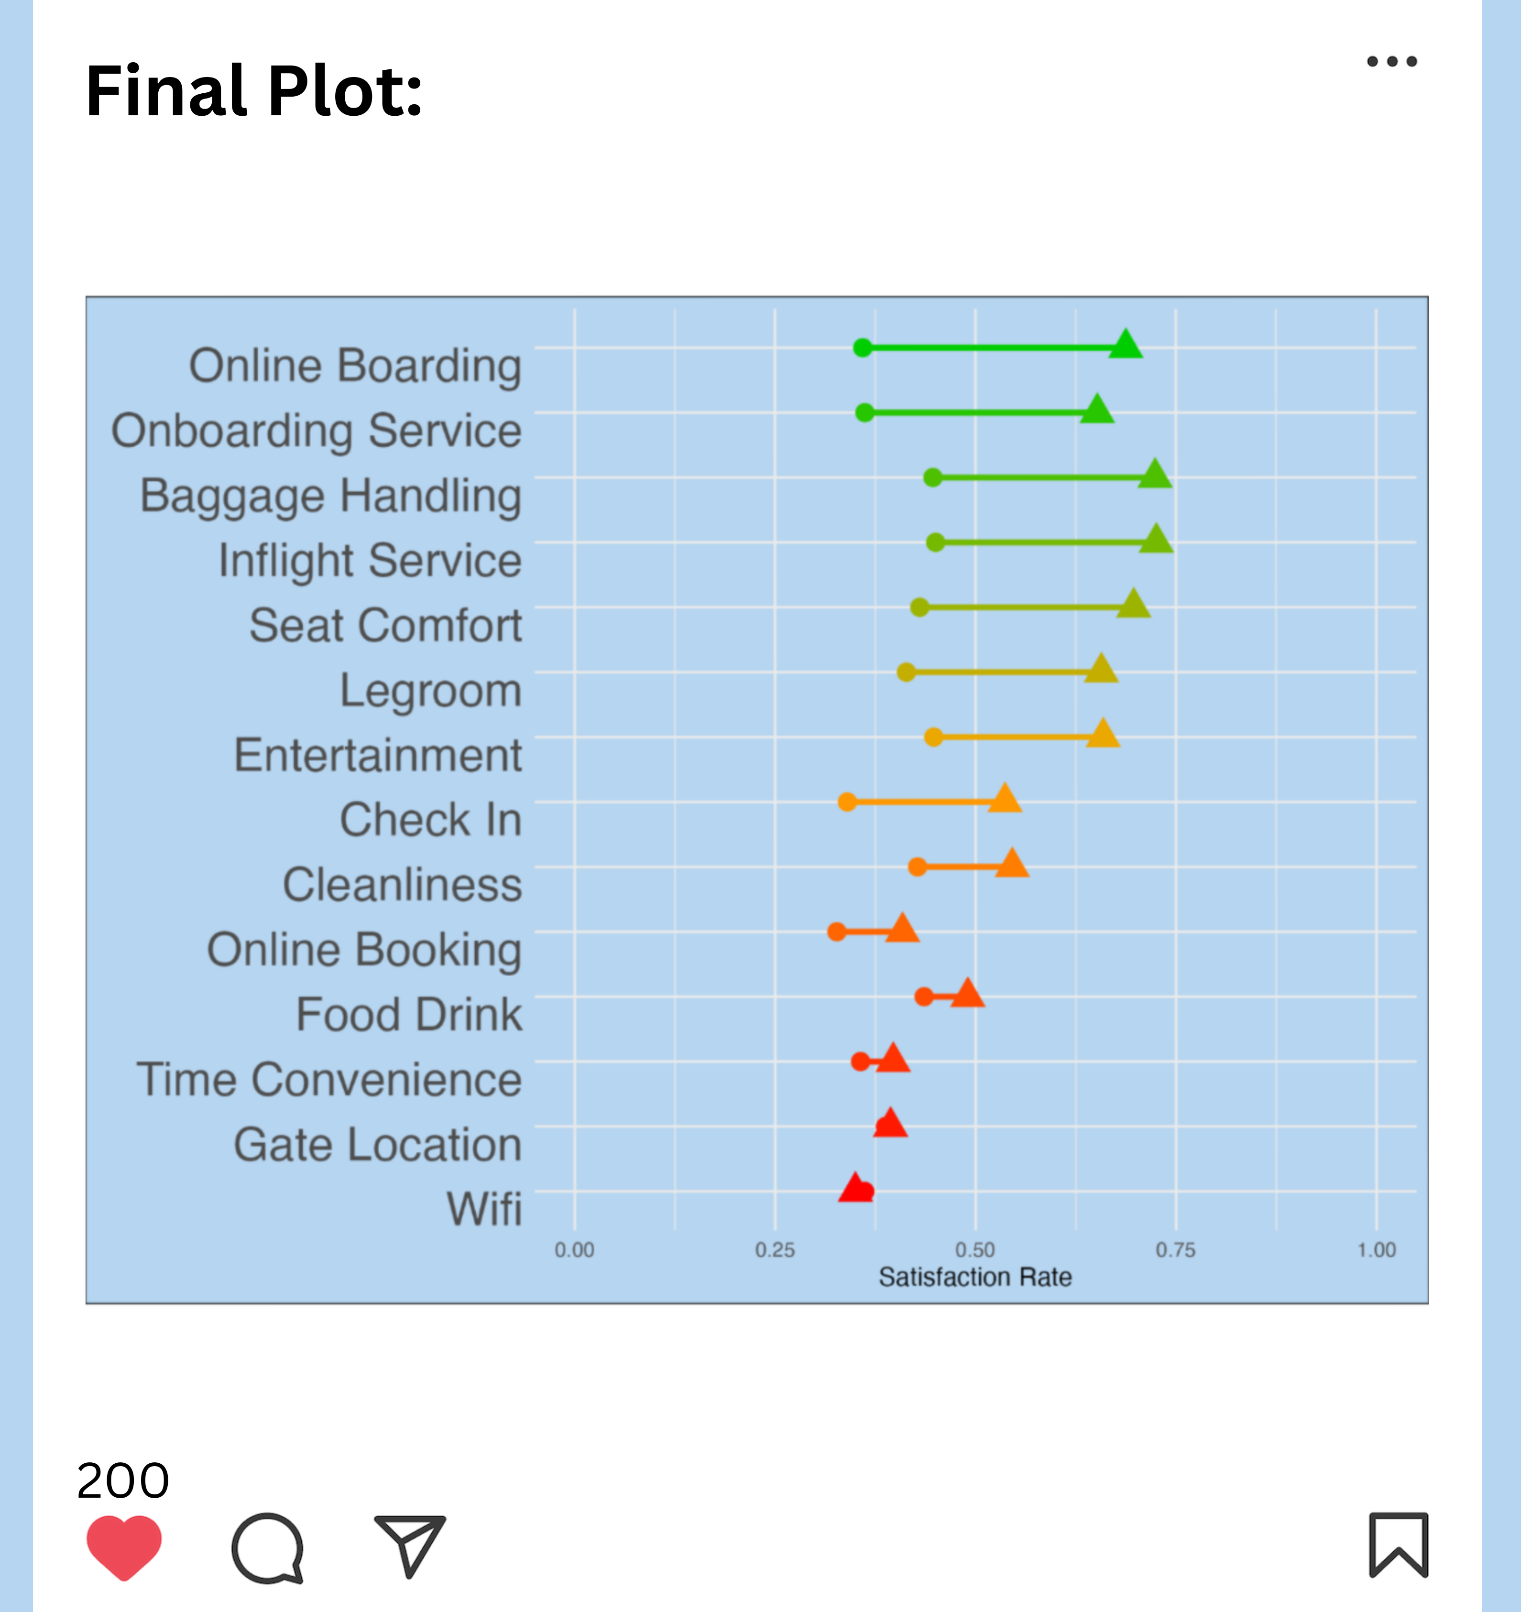

Slide 8
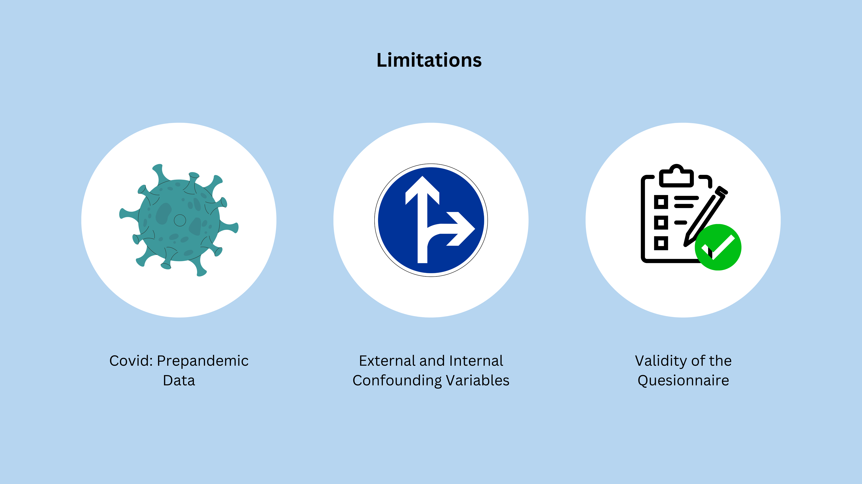
Notes:
In the beginning, it was difficult to integrate the issue of climate change and the problem the aviation industry Is creating for the earth. A limitation of our results are that the data set is from 2015 so those are precovid data and the airtravel might have changed quit a bit.
Moreoever, we haven’t considered all external and internal confounding variables (such as external: socioeconomic status, purchasing power; and internal: flight distance, what the different services entail)
And finally, the Validity of the questionnaire cannot be assessed
Overall during the project, we had a great time and fun working together as a team and learned a lot, making the seminar a truly enjoyable and educational experience.

